Slide 1

Water balance-based tool for drought proofing agricultural watersheds
Mohammad Faiz Alam
Researcher – International Water Management Institute
m.alam@cgiar.org

Slide 2

Drought proofing ITC Agri-Catchments
STABILISING CROP PRODUCTION: All crops in watershed
Defining drought proofing, since no consistent definition exists
Developing framework and indicators for assessing drought proofing;
Defining interventions required to achieve drought proofing and assessing ongoing activities in terms of their drought-proofing ability
WATER AS A RESOURCE: Technical assessment
FRAMEWORK: Simple and robust and location agnostic

Slide 3
Defining Drought Proofing Agri-Catchments
Ensuring the capacity to meet the basic material and physical needs of the local population (both human and animal) during a drought so that there is minimal distress
In the context of agri- catchments
Drought proofing is defined as
“Preparing catchments to face drought with the minimum possible adverse effects by efficient and effective use of water resources with the objective of stabilizing crop production”
Outcome of stabilizing crop production: enhanced farmers’ drought resilience at micro level and stabilizing farm incomes.
How water management (supply and demand) can achieve this.

Slide 4
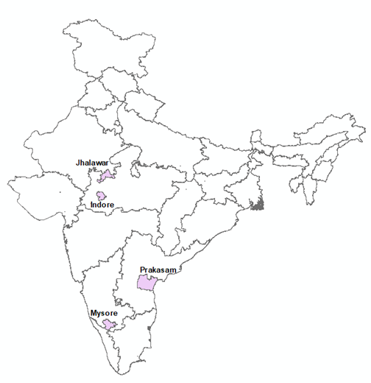
Drought Proofing Agri-Catchments
Drought proofing is a continuous process
Drought proofing spans over both normal, drought and surplus years
Real preparedness to drought proofing should actually happen during the non-drought years by harvesting and storing water and judiciously using water
During drought years with scanty rainfall, it’s preparedness and carryover storage with efficient water management that helps.
On a long term basis, there are essentially two water related drought proofing meaures
Harness water through water harvesting/conservation, spread of irrigation, groundwater recharge & watershed development
Promote demand management measures including water use efficiency and water productivity improvement, drought tolerant and short duration crop varieties

Slide 5
Assessing Drought Proofing: Methodology
Design principle: Scientifically robust but simple to be applied on field by with minimum training
Drought risk assessment
Rainfall deficit: Frequency, Severity and Timing
Framework and indicators
Indicators
Application
Apply to Agri-catchments
Suggest and assess interventions
What and how to measure
Hydrology drought
Conceptual framework
Water balance tool

Slide 6

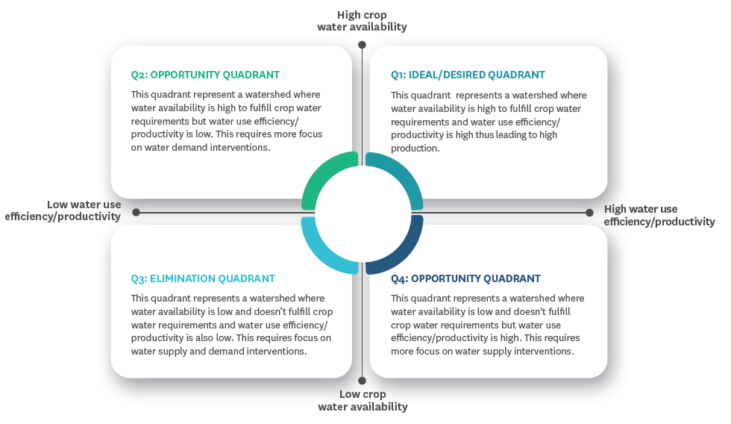
Conceptual framework

Slide 7
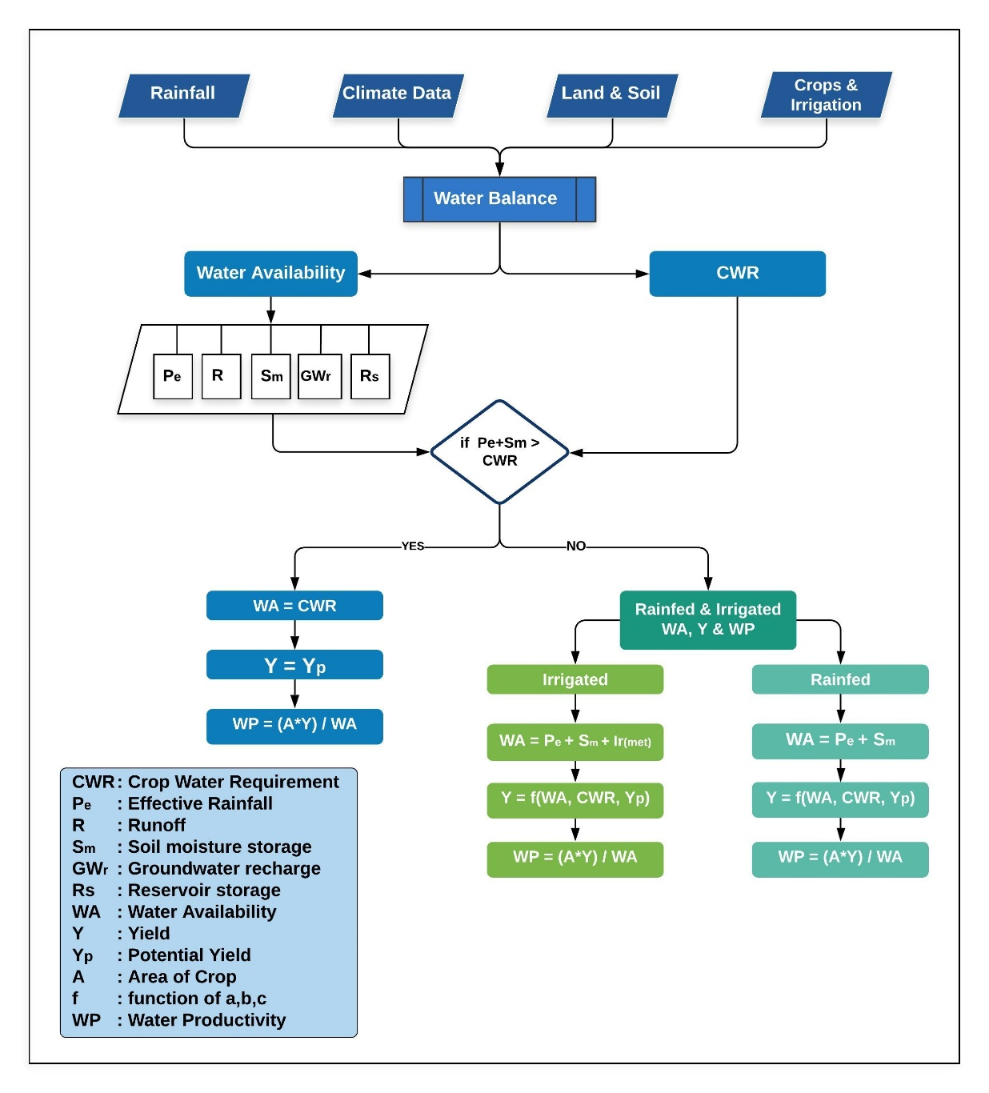
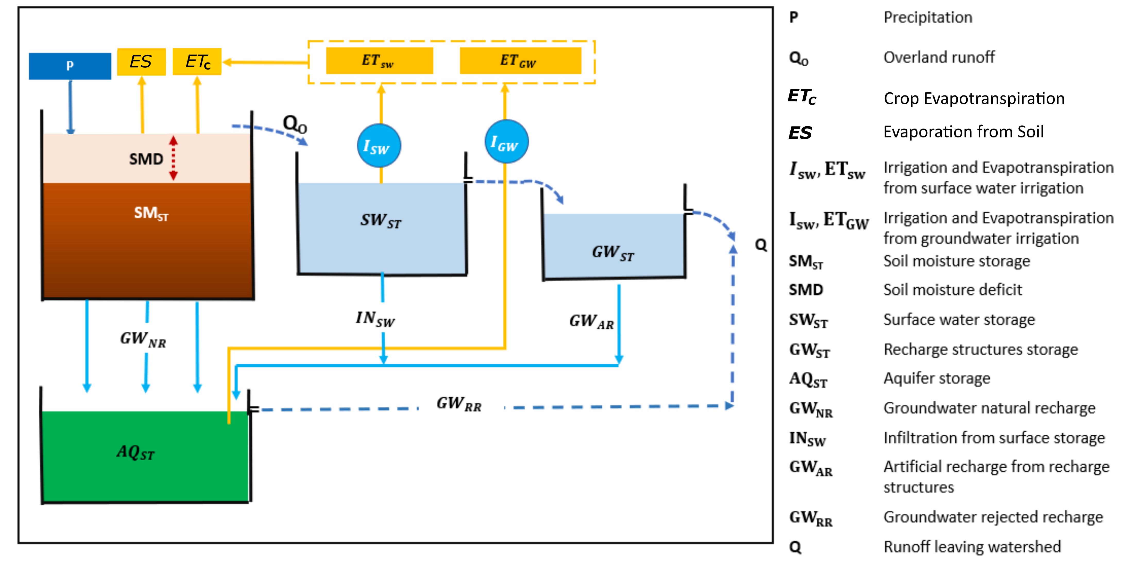
Process Flow

Slide 8
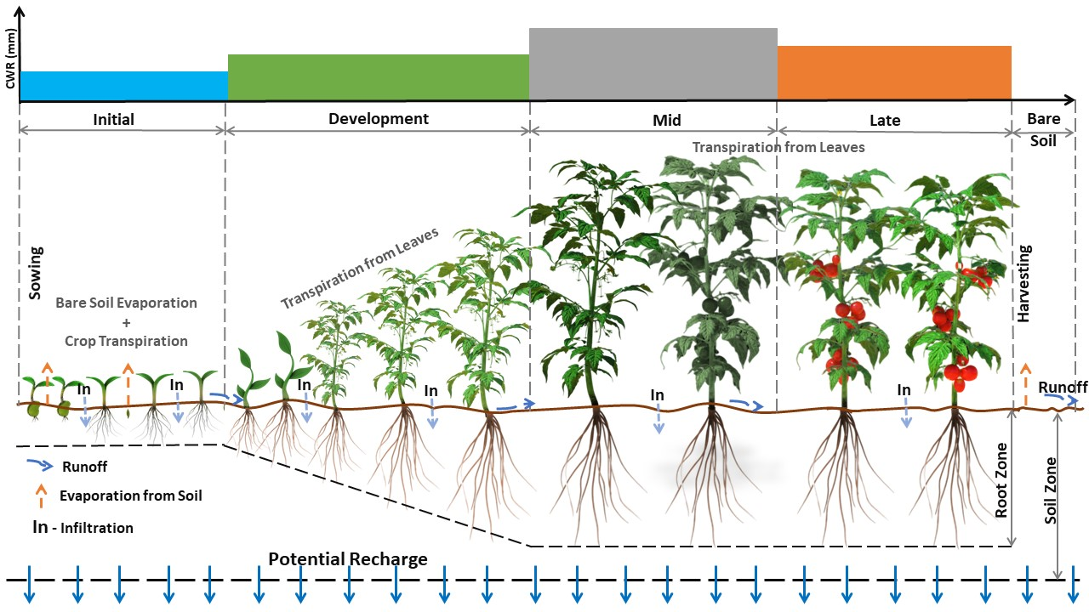
Robust Methodology (Backend)
FAO 56
FAO Crop yield response
USDA CN
Dynamic root growth
Daily soil moisture and stress
Groundwater storage: Bucket

Slide 9
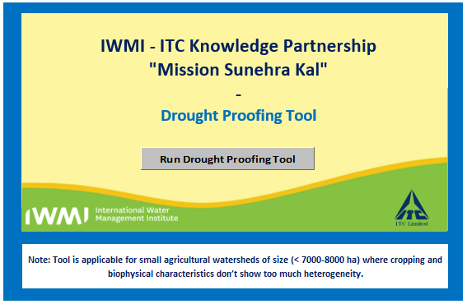
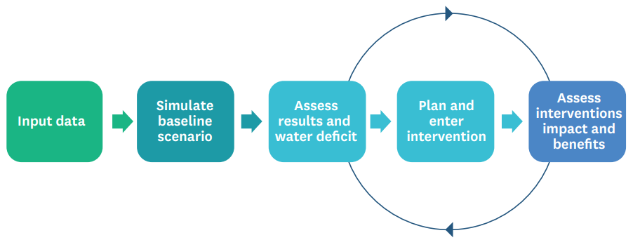
Operationalize: Drought Proofing Tool
Excel based, simple but conceptually robust
Inbuilt default datasets, minimum data requirements
To help in site specific water balance, crop yield and crop requirement assessments
Simulate scenarios to assess impact of planned interventions on drought proofing

Slide 10


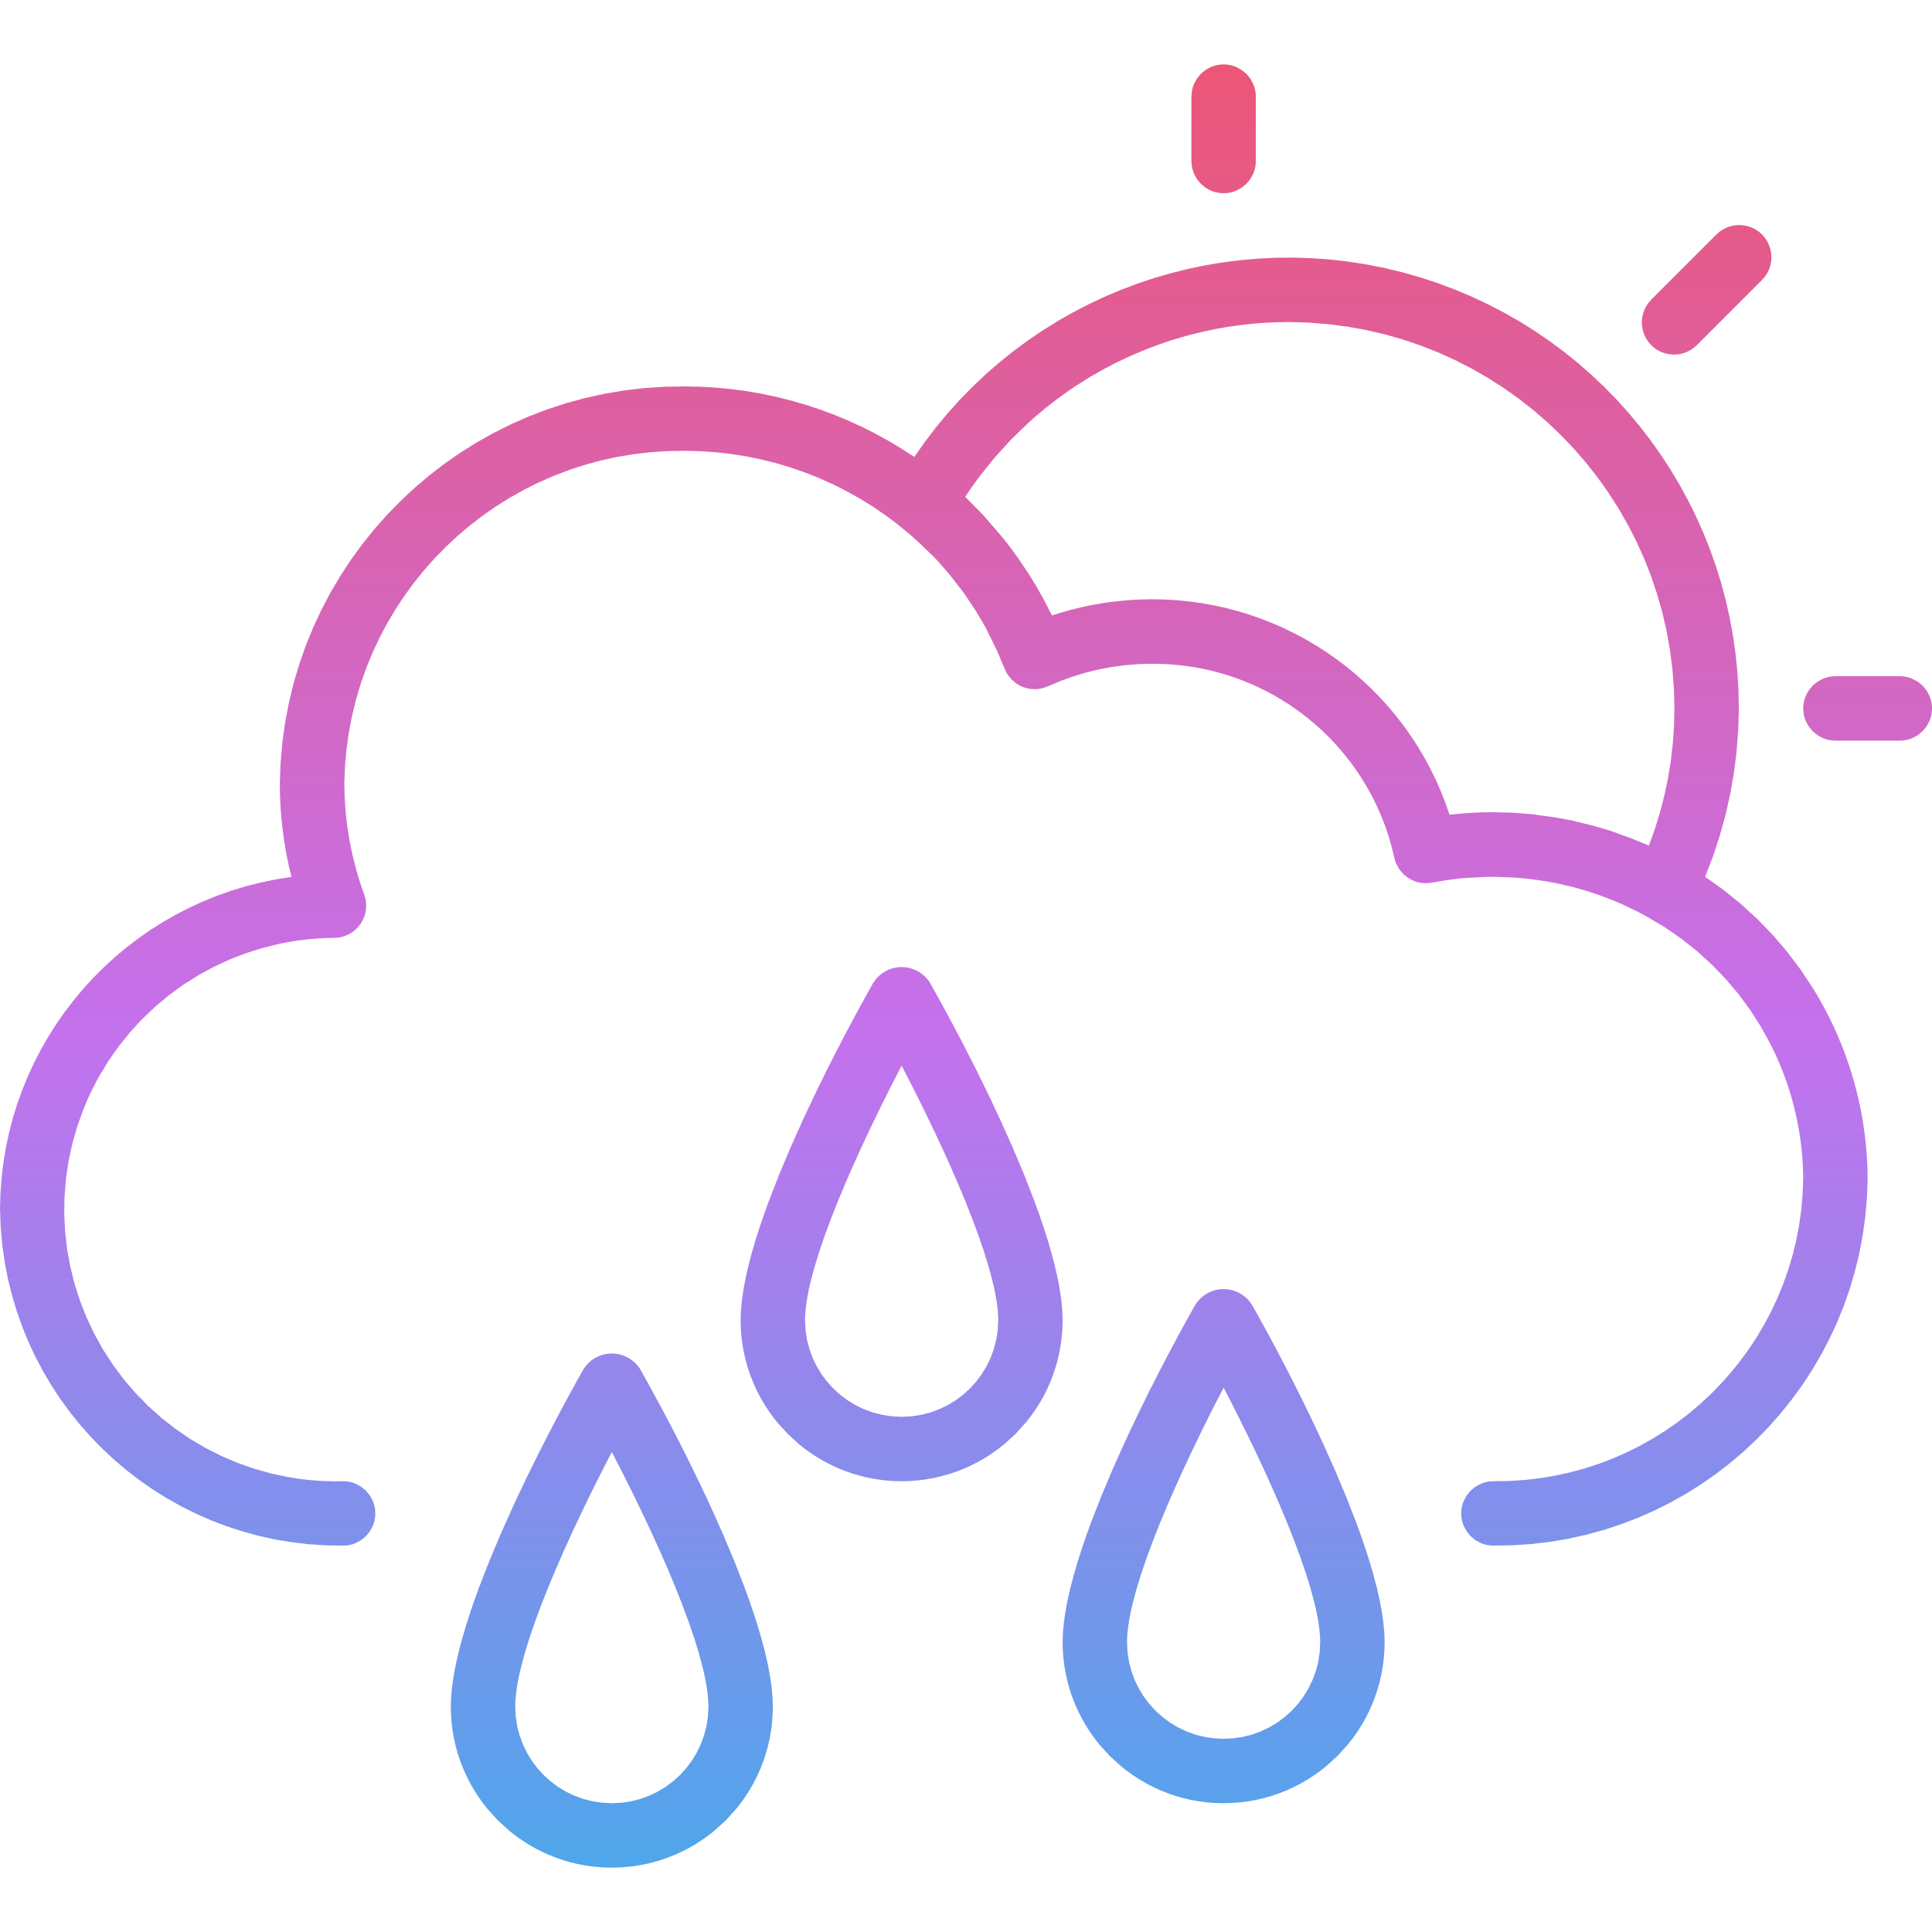
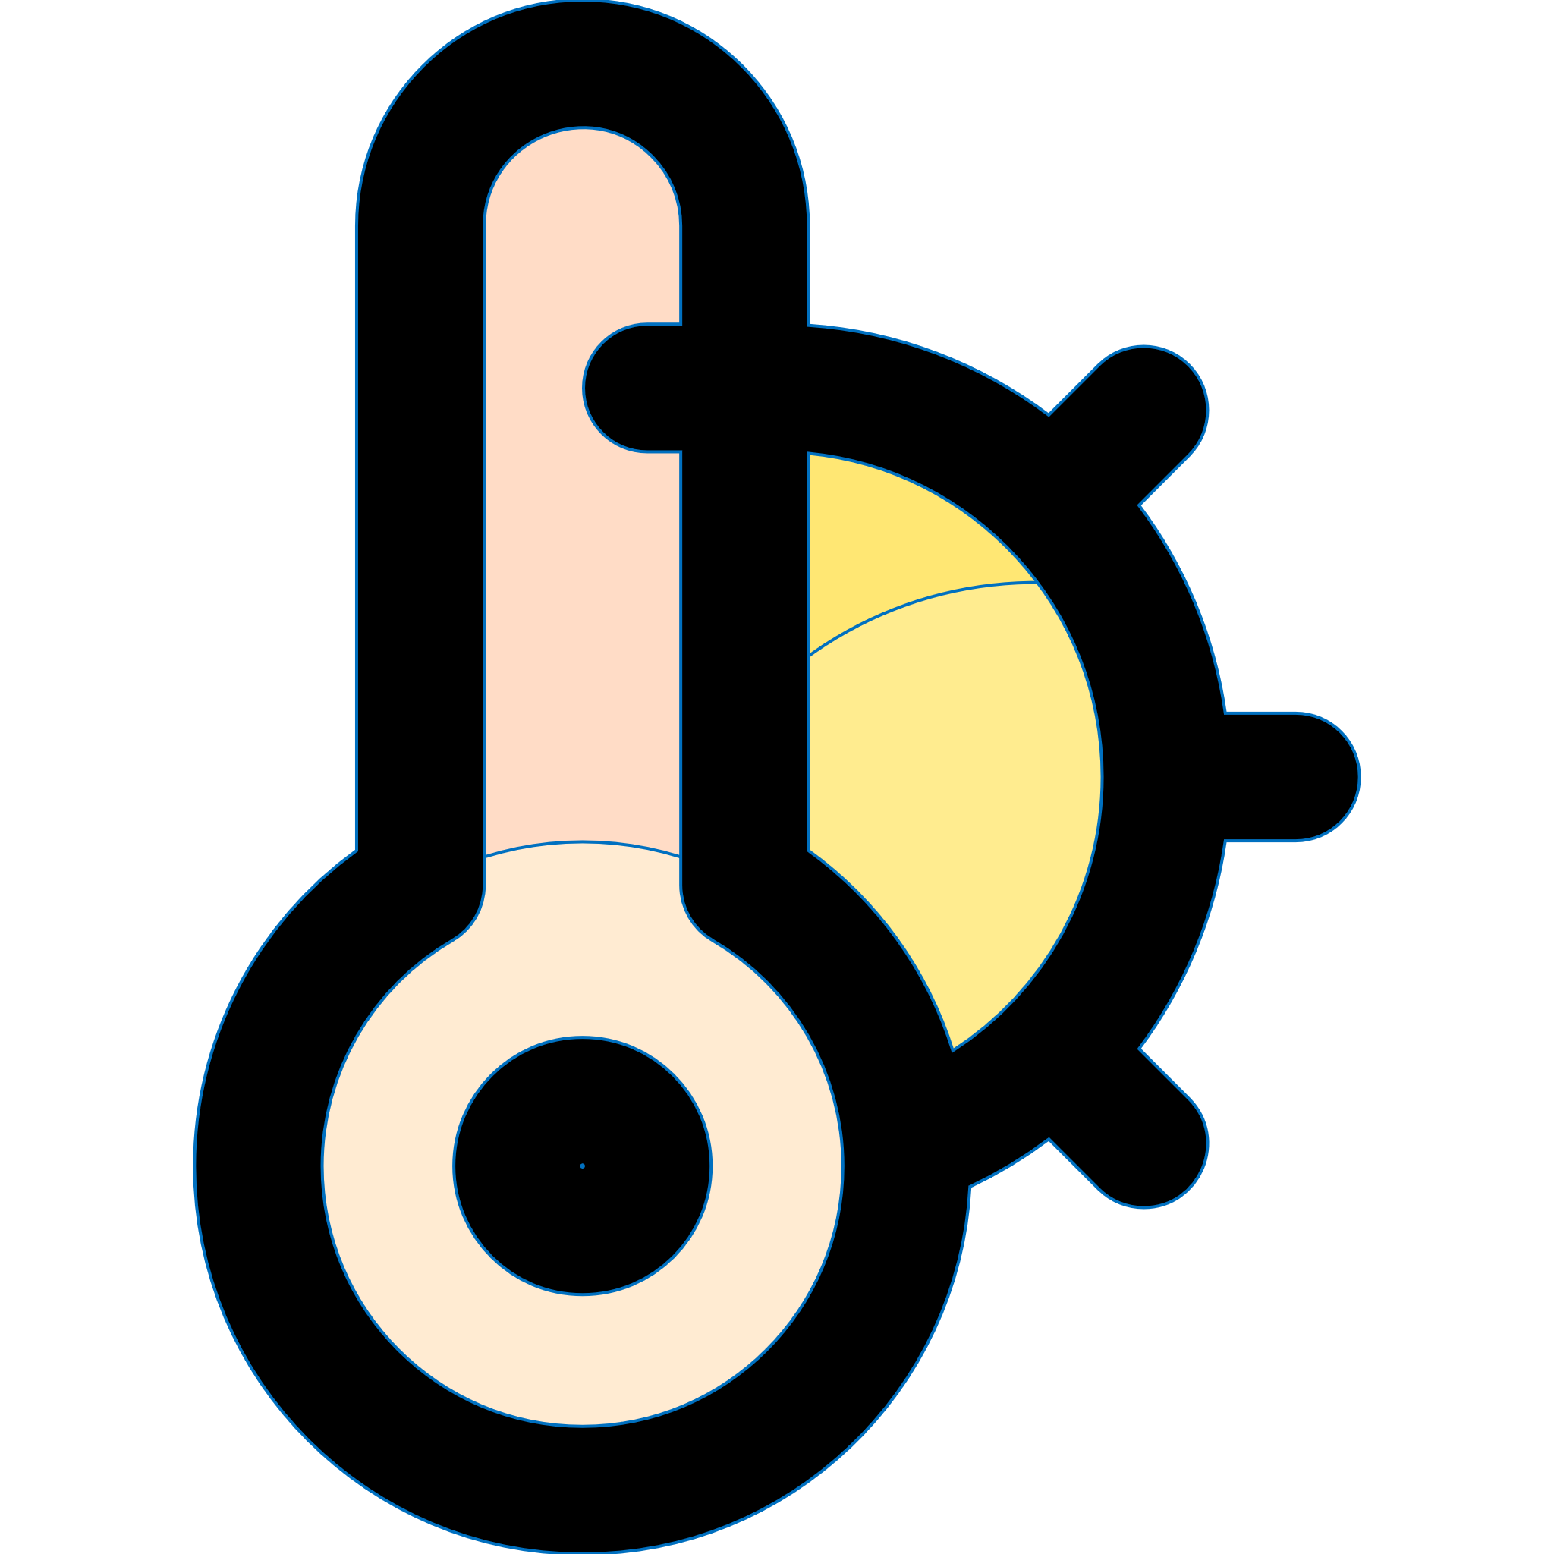



Easily acquired input Parameters
User Inputs
Land Use & Soil
Soil Types, depth & Distribution
Hydrological condition
Land Use Land Cover Data
Latitude & Hemisphere
Inbuilt Database
CN, Radiation | Matrix of land use & Soil Solar radiation
Soil | Infiltration rate Field capacity Wilting point
Crops | Crop growth duration Crop coefficient Yield response factor Root depth Crop yieldPrice Depletion factor Return flows
Intervention | Impact of water balance components, costs..
Rainfall & Temperature
Daily Rainfall data
Monthly Min & Max temperature
SPI categories
Crop Pattern
Crop Type and growth duration
Upto 9 crops
Rainfed & Irrigated area
Sowing Month & Week
Irrigation & Domestic
Irrigation Efficiency
Groundwater & Surface water dependency (%)
River / Canal water availability
Population & daily water usage

Slide 11

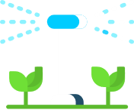

Defining Scenarios & Interventions
Supply Side Interventions
To Augment Water Storage
Increase Groundwater Storage
Interventions
Demand Side Interventions
Increase irrigation efficiency
Save Water
Economics
Evaluation Period
Interest rate
Simulating Water Balance for Different drought years:-
Normal Rainfall Year
Mild Drought
Moderate Drought
Extreme Drought
Severe drought
To begin with, water balance is simulated for baseline scenarios without any intereventions to set benchmark
Scenarios
Soil Moisture Interventions
Reduce Runoff & Soil Evaporation
Increase moisture holding capacity of Soil
The efficiency and impact of each intervention is Pre-defined in the tool with option to modify based on site conditions

Slide 12

Inbuilt Water Management Interventions
Supply Side
Interventions
Demand Side
Interventions
Soil Moisture
Interventions
Farm Pond
Farm Pond (Lined)
Infiltration Ponds
Injection/Borewell
Check dams / Gully Plugs
Tank desilting
Drip Irrigation*
Sprinkler*
Land Levelling
Ridge & Furrow Irrigation*
Deficit Irrigation*
Direct Seeded Rice (DSR)*
Alternate Wetting & Drying (AWD)*
System of Rice Intensification (SRI)*
Cover Crops*
Mulching*
Conservation Tillage
Bunds (Field / Contour Bunds)
Broad bed Furrows*
Increase water availability in surface and groundwater for irrigation
Increase irrigation water application efficiency
Increase soil moisture and Reduce runoff and increase recharge
* Crop Specific

Slide 13
Output
Output | Description
Water Balance Results Water Productivity Crop Yield, CWR & Production Economic Analysis | Water Balance Results Rainfall, Runoff, Recharge & Evaporation Annual & Monthly results Results for each scenario | Water Productivity Provides details on yield per unit of water applied (Kg/cu.m) Rainfed & Irrigated Crop Water productivity Overall results & Cropwise results | Crop Yield, CWR & Production Crop Water Requirement & Irrigated Water Requirement Rainfed Crop yield & Rainfed CWR met (in %) Irrigated Crop yield & Irrigated CWR met (in %) Overall Crop Yield (%), Production (tonnes) & CWR met (%) | Economic Analysis Total cost of all interventions Monetary Benefits Benefit-Cost Ration (BCR)

Slide 14
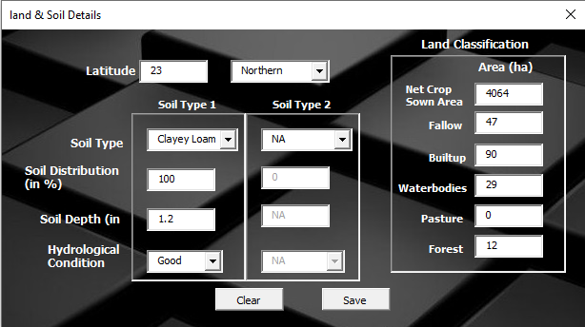
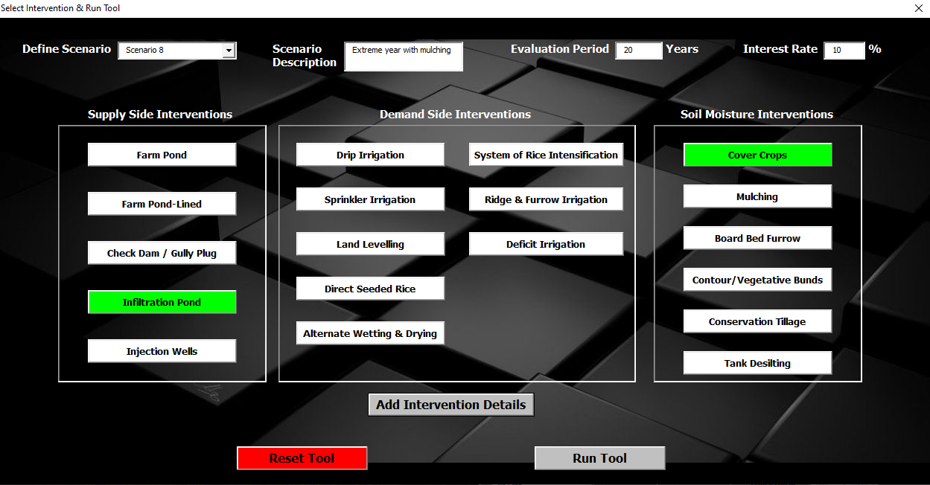
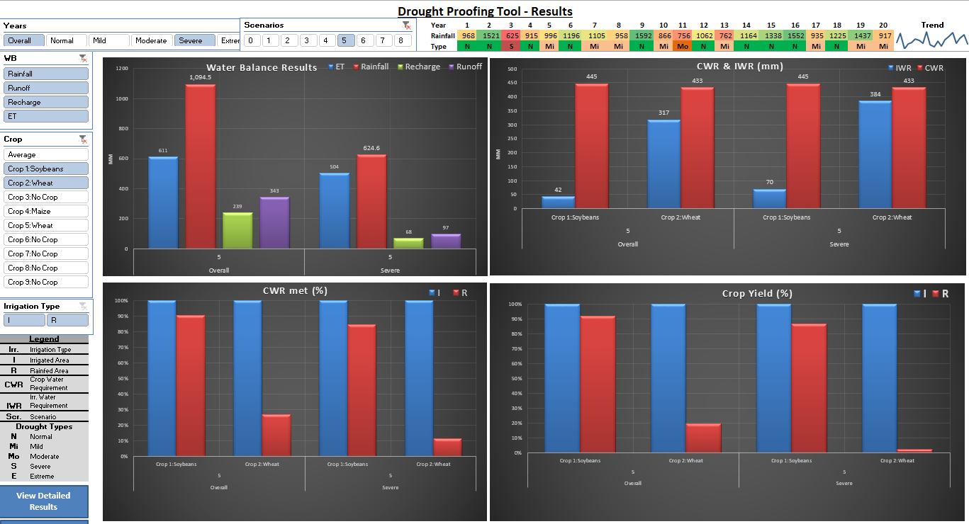
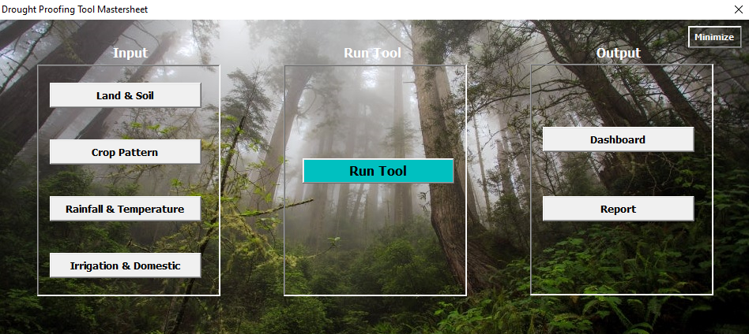
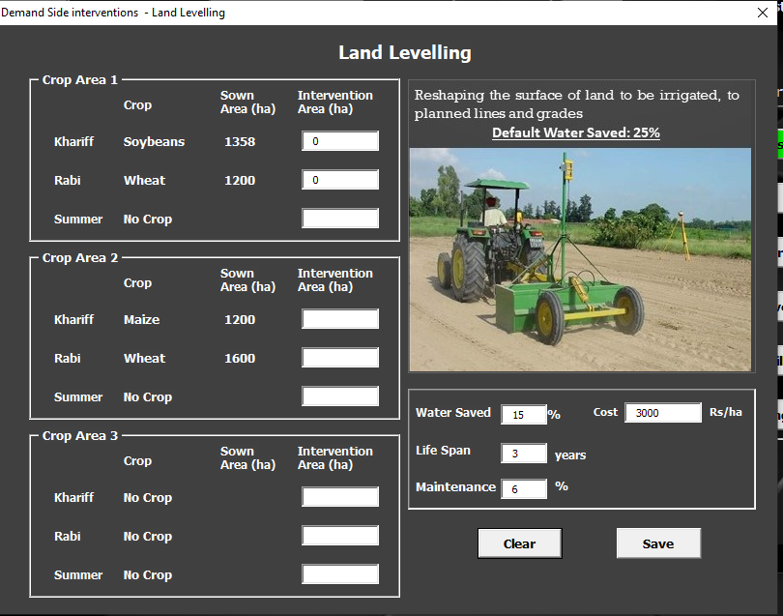
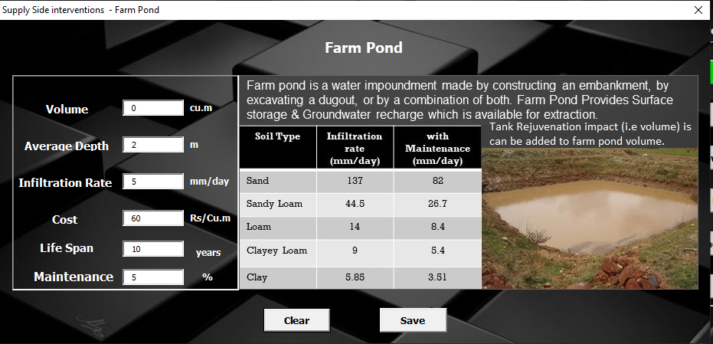
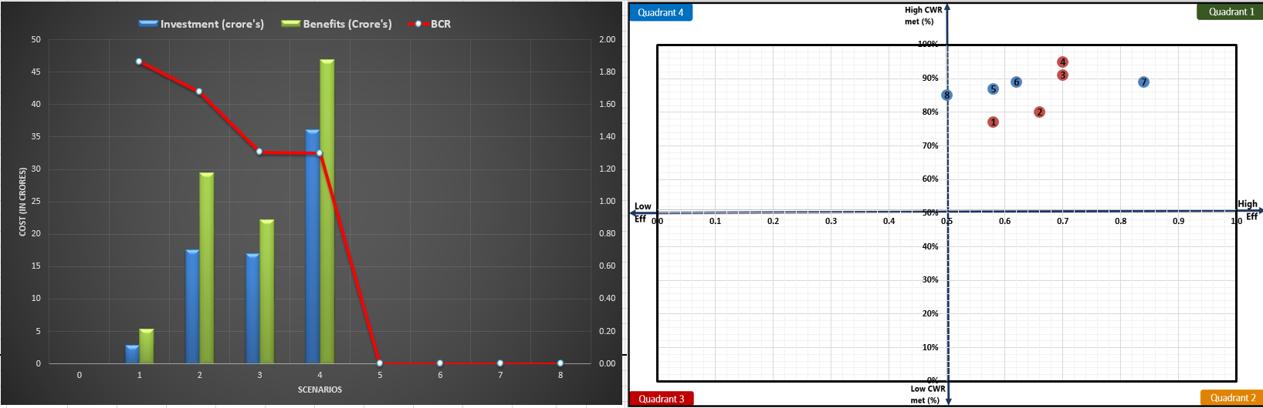
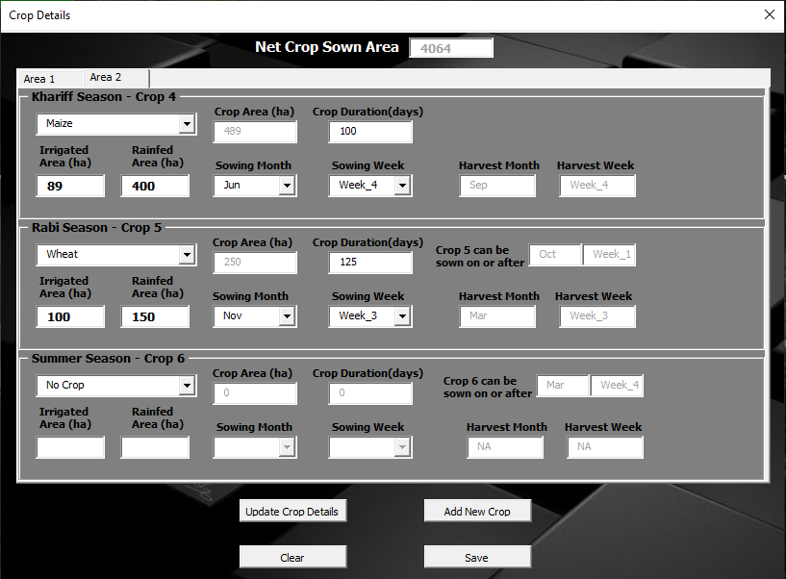

Slide 15
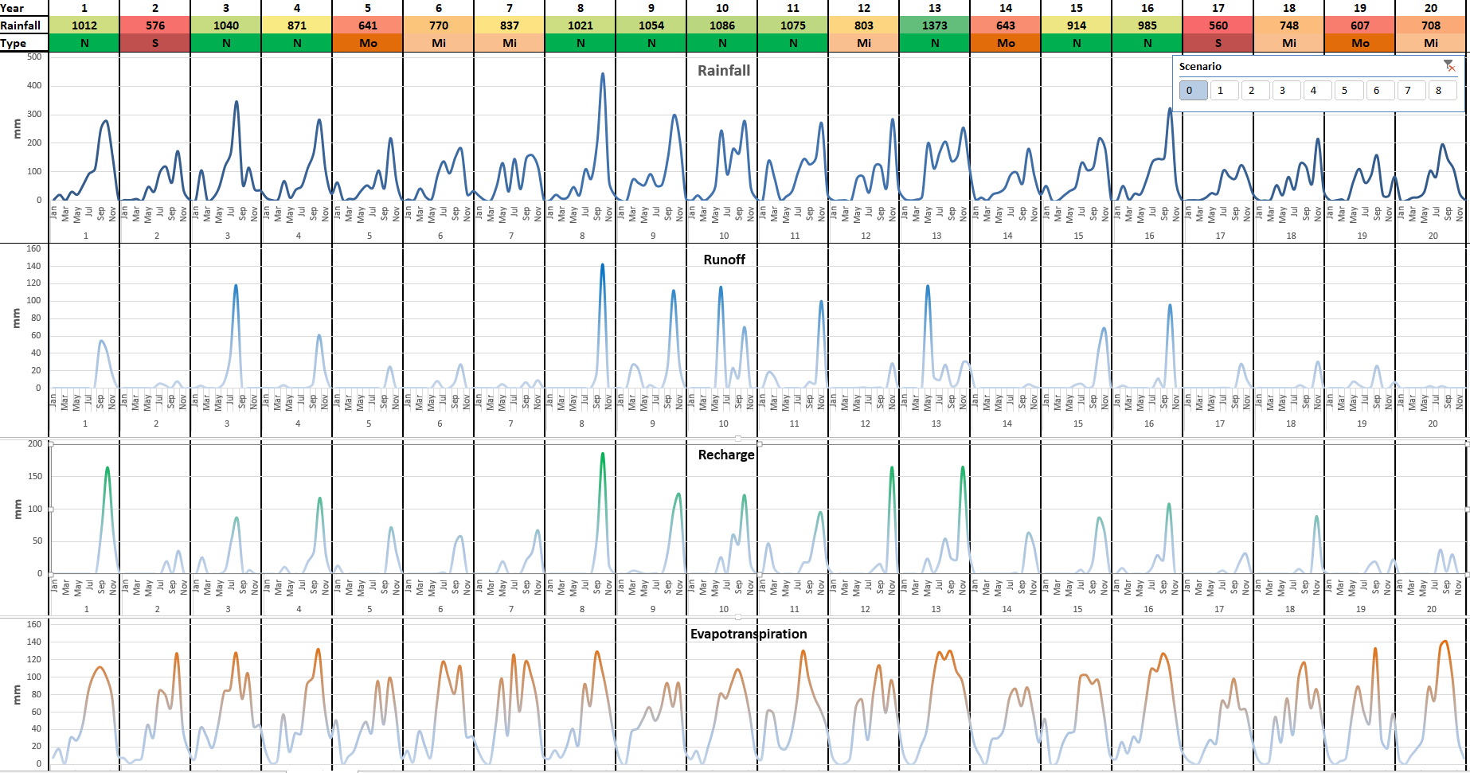
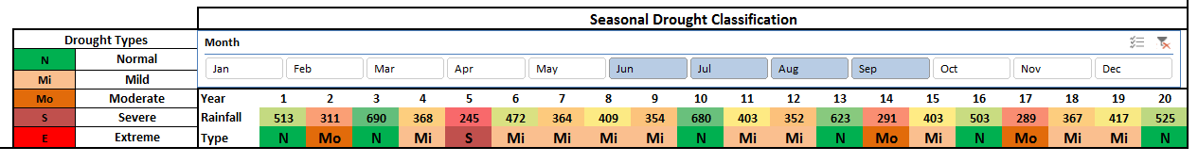
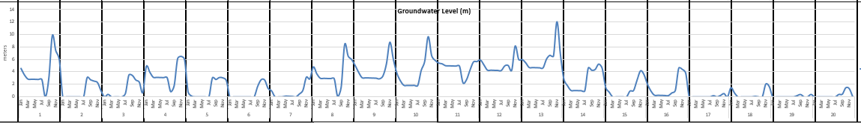

Slide 16


What it is?
Limitations > To be developed
Simple tool for field level NGO partners
To assess water availability and requirements
Gives an idea what interventions to plan and what potential benefits will be
Prepare DPR
For small (10-100 km2) homogenous agri-catchments
Easy to use, no software requirements (other than excel)
Not a replacement for sophistical models' researchers can use and understand
Not for large watersheds with heterogeneity
Lumped. Not for identifying sites for interventions within watershed
Water specific drought proofing

Slide 17
Thank You
Mohammad Faiz Alam
Researcher – International Water Management Institute
m.alam@cgiar.org

